Slide 1
MRA Project ML 2
Priyadharshini K
PGP – DSBA Nov-C Batch, 2021
kpriyadharshinik@gmail.com
Tableau Public Link
https://public.tableau.com/views/MRA2_16330836865020/Sheet1?:language=en-US&:display_count=n&:origin=viz_share_link

Slide 2
Agenda [Table OF CONTENT]
Problem Statement
Executive Summary
EDA
EDA Summary
MBA
MBA Summary

Slide 3
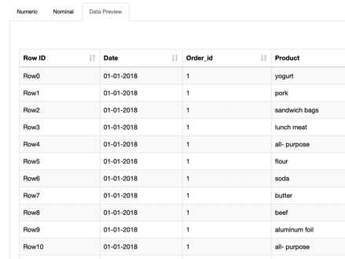
PROBLEM STATEMENT
A Grocery Store shared the transactional data with you. Your job is to identify the most popular combos that can be suggested to the Grocery Store chain after a thorough analysis of the most commonly occurring sets of items in the customer orders. The Store doesn’t have any combo offers. Can you suggest the best combos & offers?
The project involves conducting a thorough analysis of Point of Sale (POS) Data for providing recommendations through which a grocery store can increase its revenue by popular combo offers & discounts for customers.
ABOUT DATA
DATA PREVIEW
The dataset has a total of 3 variables – Numeric (Order id - int64(5)) , String (Product - object(12)), Date - datetime64(1)
Nominal Variable : Date has 603 unique values while Product has 37 unique values
Number Variable : Order Id

Slide 4
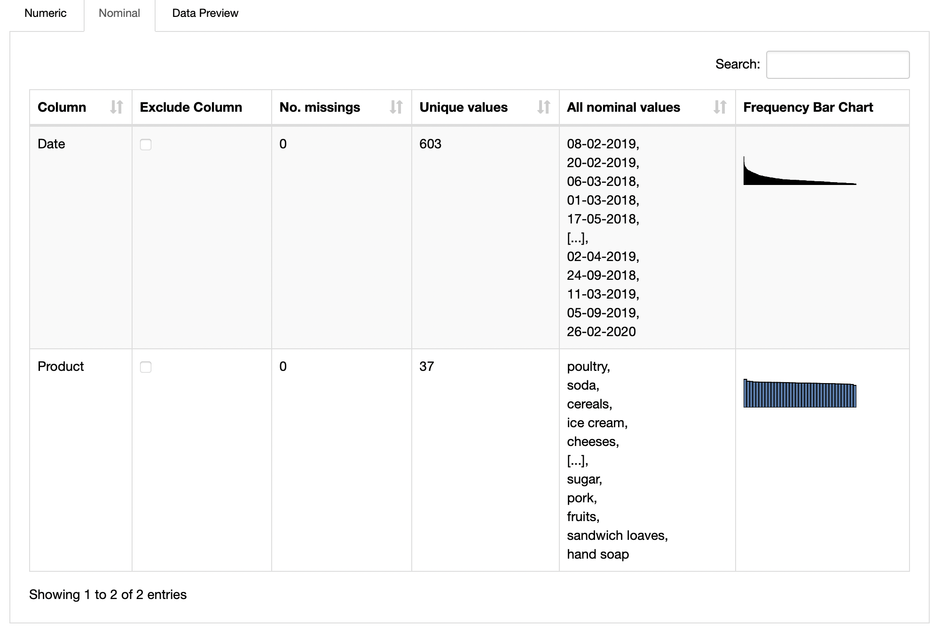
EDA - Univariate Analysis Tool Used: KNIME
Poultry, Soda, Cereals have the maximum number of Orders in the descending fashion

Slide 5
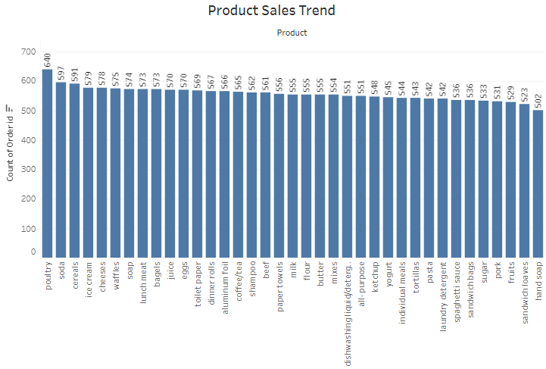
EDA - Univariate Analysis Tool Used: Tableau
Poultry has the maximum number of Orders, followed by Soda and Cereals

Slide 6
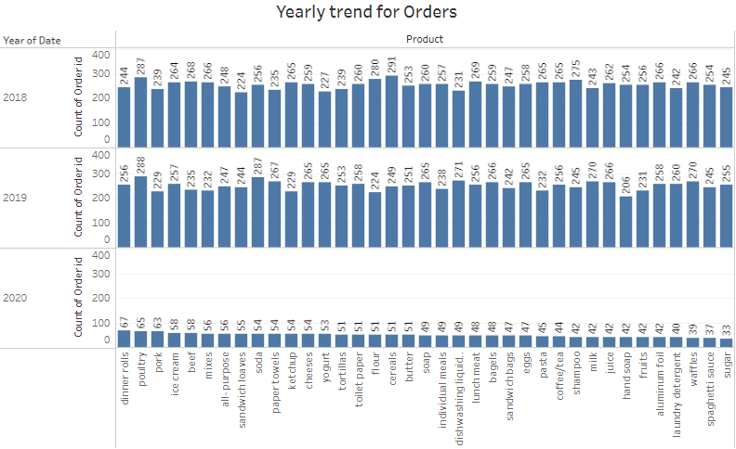
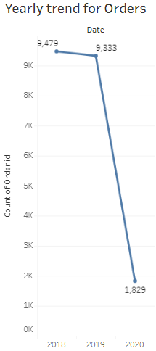
EDA - Multivariate Analysis Tool Used: Tableau
Data for Q2,Q3 is missing for 2020. The top product of Sales for 2018 differs from that of 2019

Slide 7
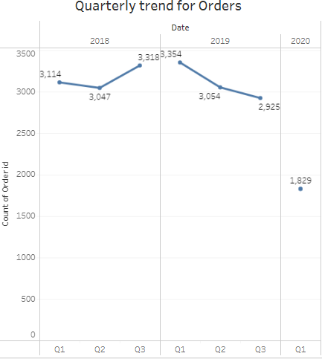
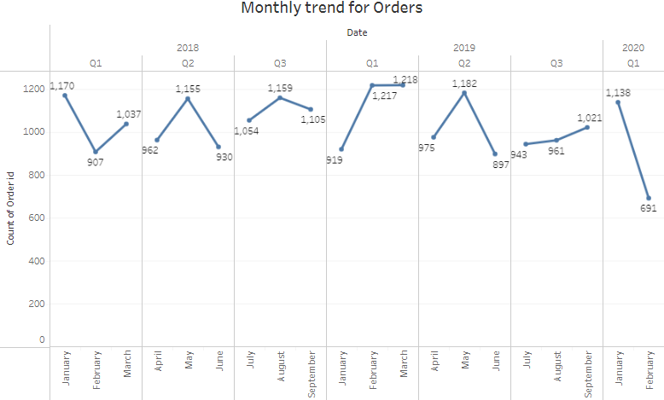
EDA - Multivariate Analysis Tool Used: Tableau
2018 – Q3 Sales is the highest, followed by Q1 and Q2
2019 – Q1 Sales is the highest, followed by Q2 and Q3
2018 – January records highest sales, while June records lowest
2019 – Q1 Sales is the highest, followed by Q2 and Q3

Slide 8
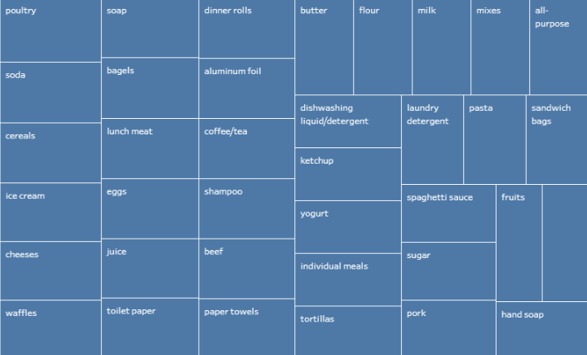
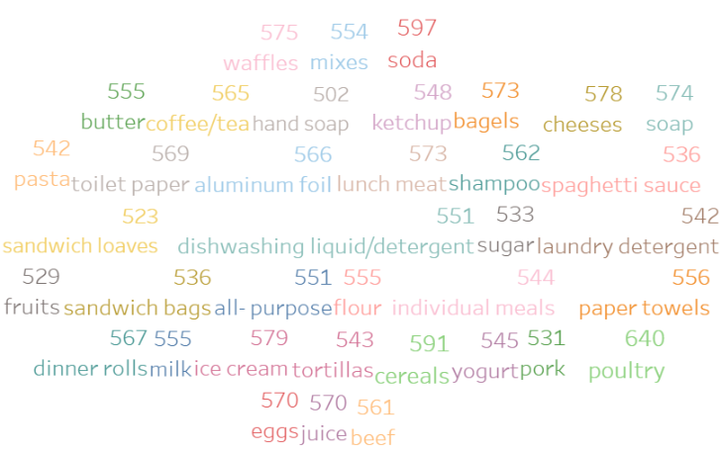
TREE CHART
WORD CLOUD
Poultry, Soda and Cereals form the highest order for all the years 2018,2019

Slide 9
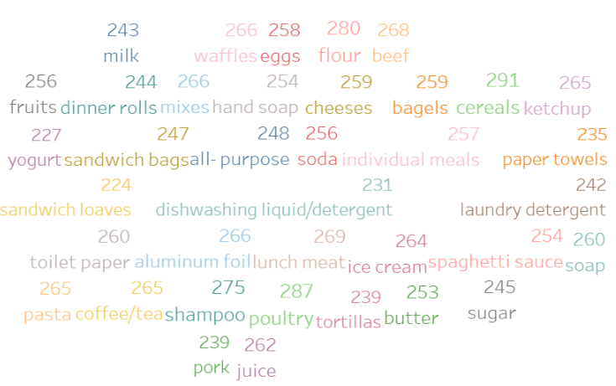
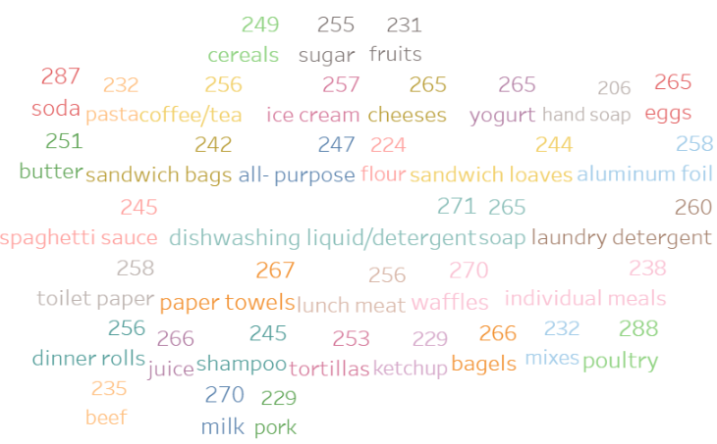
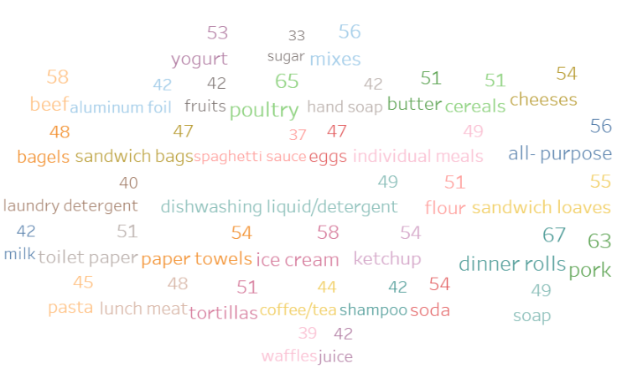
2018
2019
2020

Slide 10
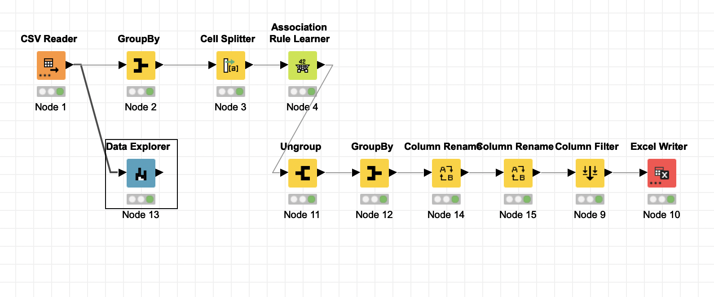
KNIME WORKFLOW

Slide 11
Association rules are "if-then" statements, that help to show the probability of relationships between data items, within large data sets in various types of databases. These rules are created by searching data for frequent if-then patterns and using the criteria support and confidence to identify the most important relationships.
Support is an indication of how frequently the items appear in the data. The probability of appearance of an item in the total number of items.
Confidence is an indication of how often the rule has been found to be true.
The confidence value of a rule, X Y with respect to a set of transactions T, is the proportion of the transactions that contains ‘X’ which also contains ‘Y’
Lift, can be used to compare confidence with expected confidence, or how many times an if-then statement is expected to be found true.
An association rule has two parts: an antecedent (if) and a consequent (then). An antecedent is an item found within the data. A consequent is an item found in combination with the antecedent.
Support and Confidence threshold value determine the total number of rules/associations possible. This can be varied for multiple iterations to get the maximum probability.
For this dataset, support is set at 0.02 while confidence is set at 0.75. This means the occurrence of an item to be checked in the dataset is checked at 2% probability and 75% of the times the recommended product is found to be associated with the basket list of items.

Slide 12
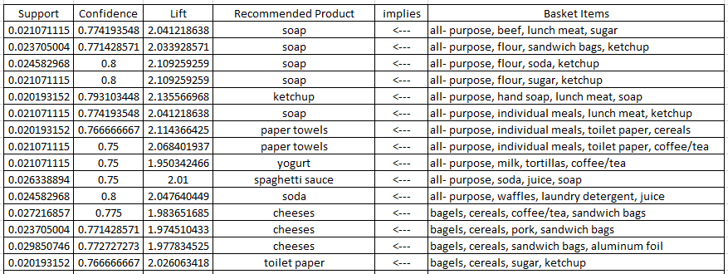
ASSOCIATIONS IDENTIFIED USING MARKET BASKET ANALYSIS
(SAMPLE OUPUT OF THE WORKFLOW)

Slide 13
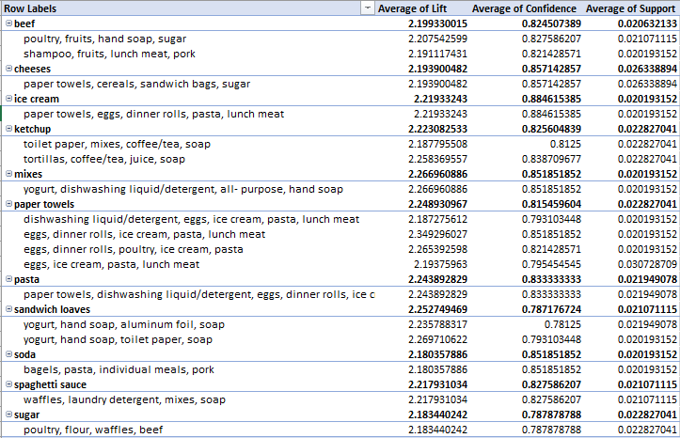
POSSIBLE ASSOCIATIONS

Slide 14
ASSOCIATIONS GROUPED BY RECOMMENDED PRODUCT IN THE PRECEDING ORDER OF LIFT
Recommended Product | Row Labels | Lift | Confidence | Support
paper towels | eggs, dinner rolls, ice cream, pasta, lunch meat | 2.349296027 | 0.851851852 | 0.020193152
paper towels | eggs, dinner rolls, poultry, ice cream, pasta | 2.265392598 | 0.821428571 | 0.020193152
paper towels | eggs, ice cream, pasta, lunch meat | 2.19375963 | 0.795454545 | 0.030728709
paper towels | dishwashing liquid/detergent, eggs, ice cream, pasta, lunch meat | 2.187275612 | 0.793103448 | 0.020193152
sandwich loaves | yogurt, hand soap, toilet paper, soap | 2.269710622 | 0.793103448 | 0.020193152
sandwich loaves | yogurt, hand soap, aluminum foil, soap | 2.235788317 | 0.78125 | 0.021949078
mixes | yogurt, dishwashing liquid/detergent, all- purpose, hand soap | 2.266960886 | 0.851851852 | 0.020193152
ketchup | tortillas, coffee/tea, juice, soap | 2.258369557 | 0.838709677 | 0.022827041
pasta | paper towels, dishwashing liquid/detergent, eggs, dinner rolls, ice cream | 2.243892829 | 0.833333333 | 0.021949078
ice cream | paper towels, eggs, dinner rolls, pasta, lunch meat | 2.21933243 | 0.884615385 | 0.020193152
spaghetti sauce | waffles, laundry detergent, mixes, soap | 2.217931034 | 0.827586207 | 0.021071115
beef | poultry, fruits, hand soap, sugar | 2.207542599 | 0.827586207 | 0.021071115
beef | shampoo, fruits, lunch meat, pork | 2.191117431 | 0.821428571 | 0.020193152
cheeses | paper towels, cereals, sandwich bags, sugar | 2.193900482 | 0.857142857 | 0.026338894
ketchup | toilet paper, mixes, coffee/tea, soap | 2.187795508 | 0.8125 | 0.022827041
sugar | poultry, flour, waffles, beef | 2.183440242 | 0.787878788 | 0.022827041
soda | bagels, pasta, individual meals, pork | 2.180357886 | 0.851851852 | 0.020193152

Slide 15
RECOMMENDATIONS:
Paper Towels go with the basket list, eggs, dinner rolls, ice cream, pasta , lunch meat / poultry.
Hence eggs, ice cream, meat and paper towels go together. Paper towels can be given as complimentary or at offer price during purchase of ice cream, meat, eggs.
Sandwich loaves and Yogurt go together and hence can be given as,
“Buy Sandwich Loaves, Get Yogurt for Free”.
Ketchup can be tied along with Tortilla as a combo pack.
Similarly, spaghetti sauce & waffles make a good combo. Combo offers can be provided to these combinatory purchases.
Beef is associated with poultry, lunch meat and pork. Hence Beef can be given as an Add-on product during purchase of lunch meat, pork / poultry at an add-on offer price.
Cheeses and sandwich bags go together. Lucrative offers can be given to Cheeses during bulk/more than 5 purchase of sandwich bags as a ‘Family Pack’ Offer.

